Slide 1
System Testing

Slide 2
System Testing
Definition: The testing of a complete, integrated software product to evaluate the system's compliance with its specified requirements.
Goal: To confirm that the fully assembled system works as designed, meets user needs, and satisfies non-functional criteria.
Scope: Addresses defects arising from component interaction, data flow, external interfaces, and resource utilization.

Slide 3
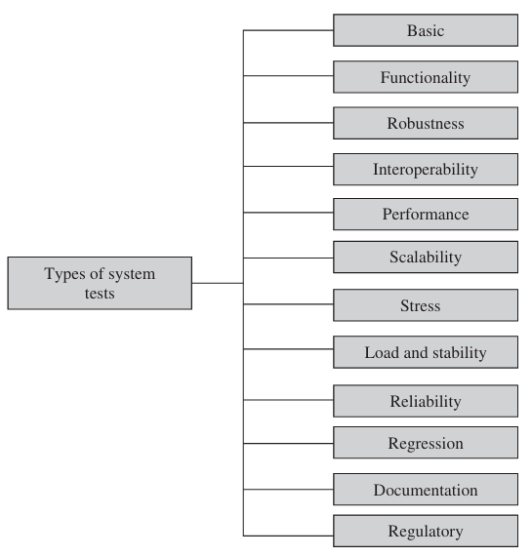
System Test Taxonomy
Notes:
Tests are broadly categorized by their focus: Functionality (what it does) and Quality Attributes (how well it performs).

Slide 4
Basic Tests
Purpose: To verify that the system can be installed, configured, and brought to a basic operational state. Serves as a gateway for full system testing.
Boot/Power-On Tests:
Upgrade/Downgrade Tests:
Light Emitting Diode Tests:
Diagnostic Tests
Power-On Selft-Test (POST)
Bit Error Test (BERT)
Command Line Interface Test
Notes:
Upgrade/downgrade tests are designed to verify that the system software can be upgraded or downgraded (rollback) in a graceful manner from the previous version to the current version or vice versa.
The LED (light emitting diode) tests are designed to verify that the system LED status indicators function as desired.
Diagnostic tests are designed to verify that the hardware components (or modules) of the system are functioning as desired.

Slide 5
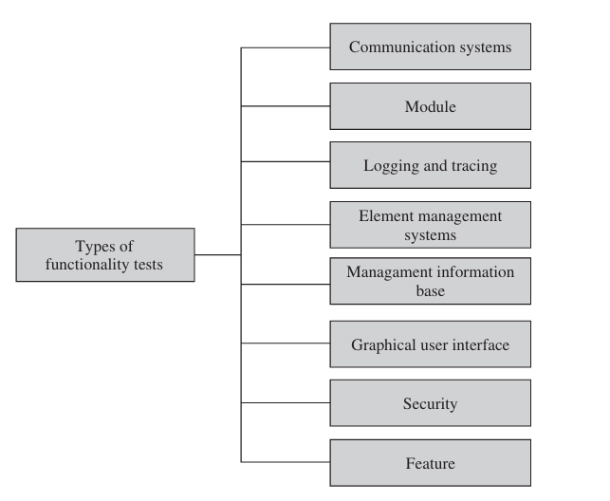
Functionality Tests
Notes:
Communication Systems Tests Communication systems tests are designed to verify the implementation of the communication systems as specified in the customer requirements specification.
Module Tests: Module tests are designed to verify that all the modules function individually as desired within the systems. Mutual interactions among the modules glue these components together into a whole system. The idea here is to ensure that individual modules function correctly within the whole system. One needs to verify that the system, along with the software that controls these modules, operate as specified in the requirement specification.
Logging and Tracing Tests: Logging and tracing tests are designed to verify the configurations and operations of logging and tracing. This also includes verification of “flight data recorder: non-volatile flash memory” logs when the system crashes. Tests may be designed to calculate the impact on system performance when all the logs are enabled.
Element Management System Test: The EMStests verify the main functions which are to manage, monitor, and upgrade the communication system network elements (NEs). Table 8.1 summarizes the functionalities of an EMS. An EMS communicates with its NEs by using, for example, the Simple Network Management Protocol (SNMP) [2] and a variety of proprietary protocols and mechanisms.
Management Information Base Test: ?
Graphical User Interface Tests: The GUI tests are designed to verify the interface to the users of an applica tion. These tests verify different components (objects) such as icons, menu bars, dialogue boxes, scroll bars, list boxes, and radio buttons. Ease of use (usability) of the GUI design and output reports from the viewpoint of actual system users should be checked. Usefulness of the online help, error messages, tutorials, and user manuals are verified.
The usability characteristics which can be tested include the following:
• Accessibility: Can users enter, navigate, and exit with relative ease?
• Responsiveness: Canusersdowhat theywant andwhentheywant ina way that is clear? It includes ergonomic factors such as color, shape, sound, and font size.
• Efficiency: Can users do what they want with a minimum number of steps and time? • Comprehensibility: Do users understand the product structure with a min imum amount of effort?
Security Tests: Security tests are designed to verify that the system meets the security requirements: confidentiality, integrity, andavailability.
*Confidentiality is the requirement that data and the processes be protected from unauthorized disclosure.
*Integrity is the requirement that data and process be protected from unauthorized modification.
*Availability is the requirement that data and processes be protected from the denial of service to authorized users.
he objective of security testing is to demonstrate
Feature Tests: Feature tests are designed to verify any additional functionalities which are defined in the requirement specifications but not covered in the above categories. Examples of those tests are data conversion and cross-functionality tests. Data conversion testing is testing of programs or procedures that are used to convert data from an existing system to a replacement system.

Slide 6
ROBUSTNESSTESTS
Robustness means how sensitive a system is to erroneous input and changes in its operational environment.
Tests in this category are designed to verify how gracefully the system behaves in error situations and in a changed operational environment.
The purpose is to deliberately break the system, not as an end in itself, but as a means to find error.
It is difficult to test for every combination of different operational states of the system or undesirable behavior of the environment.

Slide 7
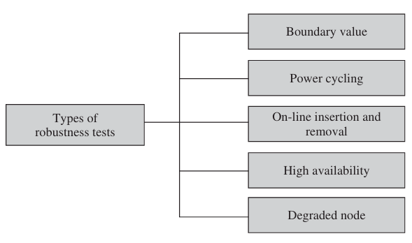
ROBUSTNESSTESTS
Notes:
Boundary Value: Boundary value tests are designed to cover boundary conditions, special values, and system defaults. The tests include providing invalid input data to the system and observing how the system reacts to the invalid input. The system should respond with an error message or initiate an error processing routine. It should be verified that the system handles boundary values (below or above the valid values) for a subset of configurable attributes.
Power Cycling Tests: Power cycling tests are executed to ensure that, when there is a power glitch in a deployment environment, the system can recover from the glitch to be back in normal operation after power is restored. As an example, verify that the boot test is successful every time it is executed during power cycling.
On-Line Insertion and Removal Tests: On-line insertion and removal (OIR) tests are designed to ensure that on-line inser tion and removal of modules, incurred during both idle and heavy load operations, are gracefully handled and recovered.
High-Availability Tests: High-availability tests are designed to verify the redundancy of individual modules, including the software that controls these modules. The goal is to verify that the system gracefully and quickly recovers from hardware and software failures without adversely impacting the operation of the system.
Degraded Node Tests: Degraded node (also known as failure containment) tests verify the operation of a system after a portion of the system becomes nonoperational. It is a useful test for all mission-critical applications.

Slide 8
Interoperability Tests
In this category, tests are designed to verify the ability of the system to interoperate with third-party products.
An interoperability test typically combines different net work elements in one test environment to ensure that they work together.
In other words, tests are designed to ensure that the software can be connected with other systems and operated.
In many cases, during interoperability tests, users may require the hardware devices to be interchangeable, removable, or reconfigurable. Often, a system will have a set of commands or menus that allow users to make the configuration changes.
The reconfiguration activities during interoperability tests are known as configuration testing.
Another kind of interoperability test is called a(backward) compatibility test.
Compatibility tests verify that the system works the same way across different platforms, operating systems, and database management systems.
Backward compatibility tests verify that the current software build f lawlessly works with older version of platforms.

Slide 9
Performance Tests
Performance tests are designed to determine the performance of the actual system compared to the expected one.
The performance metrics needed to be measured vary from application to application.
A trans action in an on-line system requires a response of less than 1 second 90% of the time.
then one needs to capture (i) end-to-end response time (as seen by external user), (ii) CPU time, (iii) network connection time, (iv) database access time, (v) network connection time, and (vi) waiting time.

Slide 10
Scalability Tests
All man-made artifacts have engineering limits.
In this group, tests are designed to verify that the system can scale up to its engineering limits.
A system which works acceptably at one level of demand may not scale up to another level.
Scaling tests are conducted to ensure that the system response time remains the same or increases by a small amount as the number of users are increased.
Systems may scale until they reach one or more engineering limits.
Notes:
There are three major causes of these limitations:
i. Data storage limitations—limits on counter field size and allocated buffer space
ii. Network bandwidth limitations—Ethernet speed 10Mbps and T1 card line rate 1.544Mbps
iii. Speed limit—CPU speed in megahertz

Slide 11
Stress Tests
The goal of stress testing is to evaluate and determine the behavior of a software component while the offered load is in excess of its designed capacity.
The system is deliberately stressed by pushing it to and beyond its specified limits.
Stress tests include deliberate contention for scarce resources and testing for incompatibilities.
It ensures that the system can perform acceptably under worst-case conditions under an expected peak load.
If the limit is exceeded and the system does fail, then the recovery mechanism should be invoked.

Slide 12
Load and Stability Tests
Load and stability tests are designed to ensure that the system remains stable for a long period of time under full load.
A system might function flawlessly when tested by a few careful testers who exercise it in the intended manner.
However, when a large number of users are introduced with incompatible systems and applications that run for months without restarting, a number of problems are likely to occur:
(i) the system slows down, (ii) the system encounters functionality problems, (iii) the system silently fails over, and (iv) the system crashes altogether.

Slide 13
RELIABILITY TESTS
Reliability tests are designed to measure the ability of the system to remain operational for long periods of time.
The reliability of a system is typically expressed in terms of mean time to failure (MTTF).
As we test the software and move through the system testing phase, we observe failures and try to remove the defects and continue testing.
As this progresses, we record the time durations between succes sive failures.
Notes:
MTBF=MTTF + MTTR

Slide 14
Regression Tests
In this category, new tests are not designed. Instead, test cases are selected from the existing pool and executed to ensure that nothing is broken in the new version of the software.
The main idea in regression testing is to verify that no defect has been introduced into the unchanged portion of a system due to changes made elsewhere in the system.
During system testing, many defects are revealed and the code is modified to fix those defects.

Slide 15
Documentation Tests
Documentation testing means verifying the technical accuracy and readability of the user manuals, including the tutorials and the on-line help.
Documentation testing is performed at three levels as explained in the following:
Read Test: In this test a documentation is reviewed for clarity, organization, f low, and accuracy without executing the documented instructions on the system.
Hands-On Test: The on-line help is exercised and the error messages verified to evaluate their accuracy and usefulness.
Functional Test: The instructions embodied in the documentation are followed to verify that the system works as it has been documented.

Slide 16
Regulatory Tests
In this category, the final system is shipped to the regulatory bodies in those countries where the product is expected to be marketed.
The idea is to obtain compliance marks on the product from those bodies.
HIPPA – Oxley-ACT etc Compliance

